Slide 1
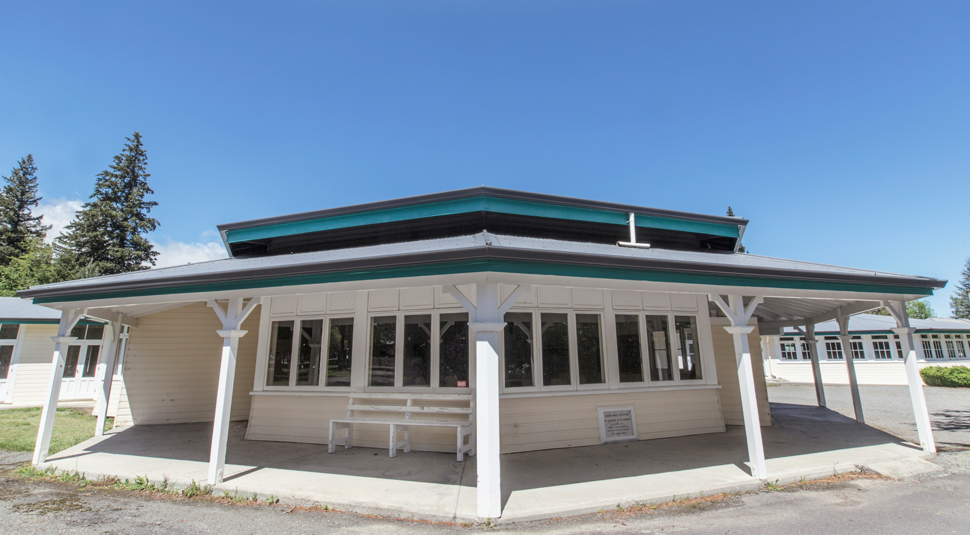
Soldiers Block Project Community Information Presentation
15 May 2023

Slide 2
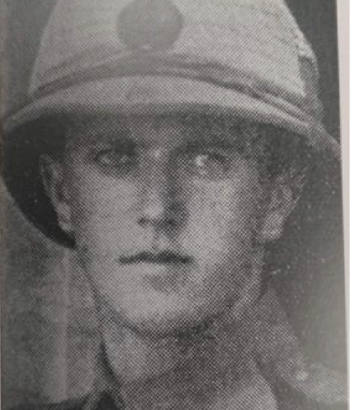
History
Constructed 1914-1916
Opened 1916 to rehabilitate soldiers from WW1
QM hospital drug and alcohol centre
Taha Maori program established
QM hospital closed 2003
October 2008 Crown agreement- vesting of the historic reserve in the Council
Centenary celebrations 2016
Strong desire from the community to use Soldiers Block

Slide 3
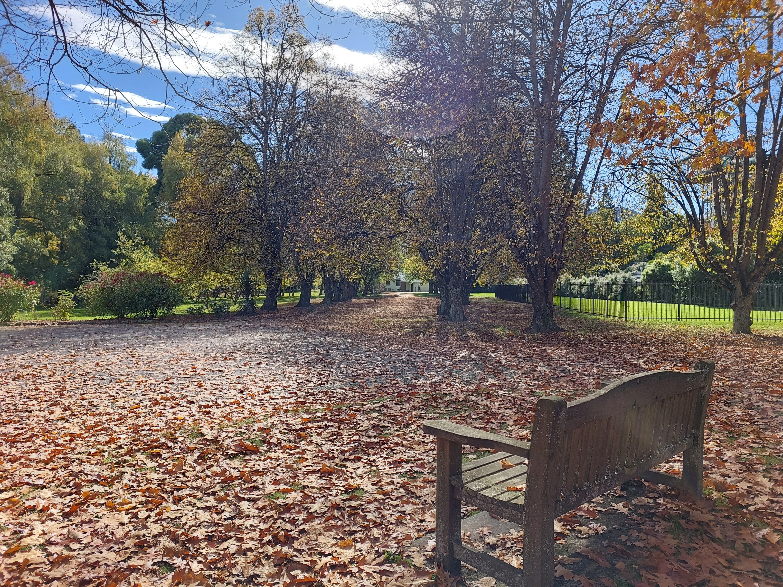
The long and winding road
Reserve Management Plan created 2011
Community input
Te Runanaga o Kaikoura
Heritage New Zealand Pouhere Taonga
Department of Conservation
Development levy established
Landscape Maintenance Plan
Conservation Management Plan
Soldiers Building steering committee formed
Community input sought
Informal expressions of interest sought

Slide 4
The long and winding roads continues
Multi use building concept investigated for funding.
Lotteries Funding application - declined
Engaged Weta workshop
Ngati Kuri engaged
A Place of Light concept developed
Building concept plan reconsidered/developed
Second Lotteries Funding application declined

Slide 5
The long and winding road gets straighter
Council formally supports project
Lotteries funding secured from Environment and Heritage Fund
Better off funding
Development contributions
Capital Project added to 2023-24 Annual Plan
Updated Conservation Management Plan
Heritage New Zealand Pouhere Taonga briefing

Slide 6
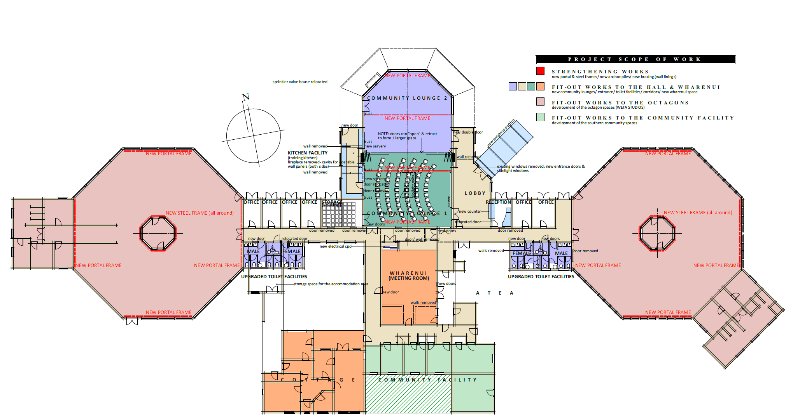
The future

Slide 8
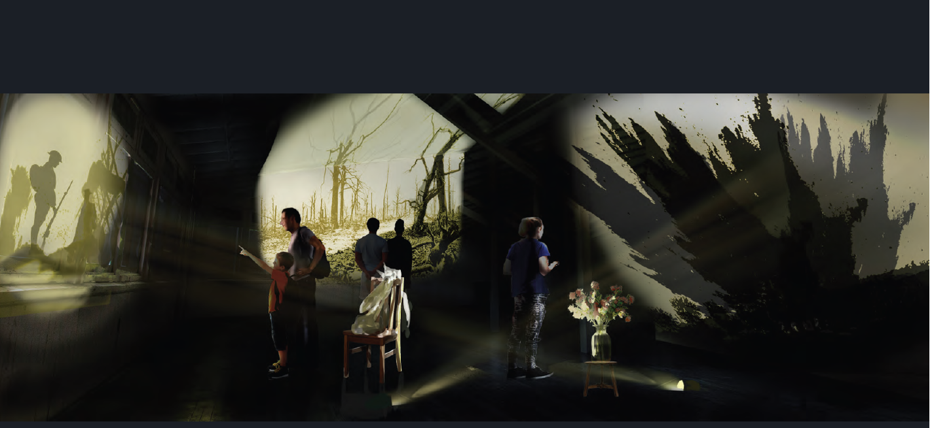
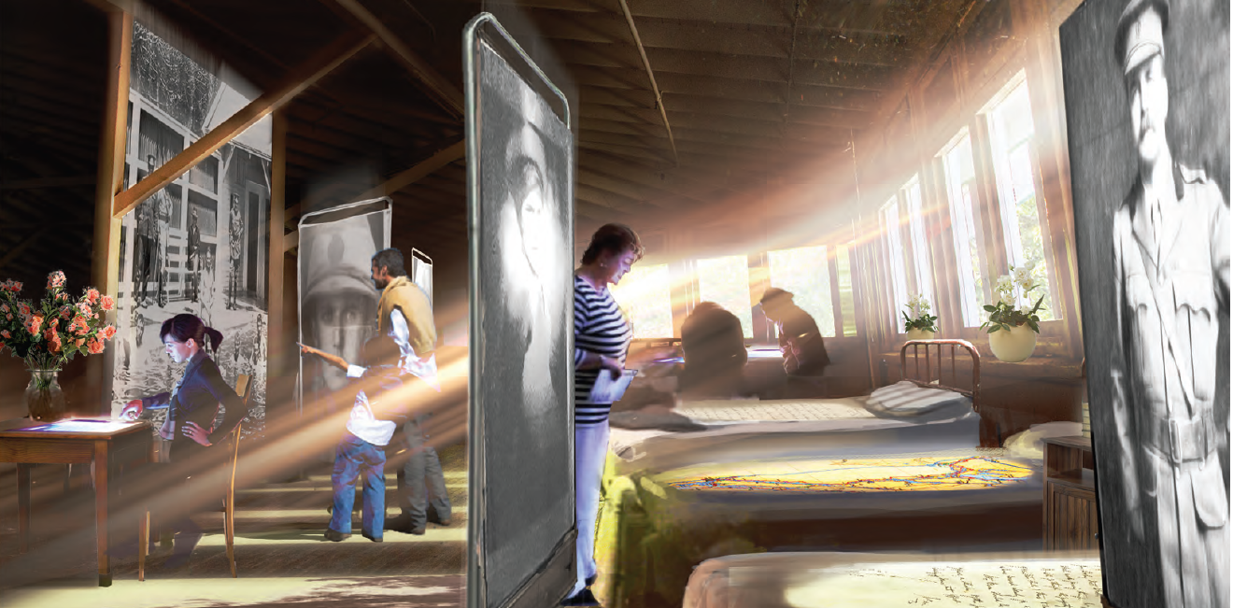
A PLACE OF LIGHT & LIFE

Slide 9
The next steps- Stage one
Heritage Management Plan, consenting etc
EQ Strengthen building and install services (power, plumbing etc)
Rehouse Amuri players wardrobe
Evaluate formation of a community liaison group
Stage two
Build & refurbish Community lounges, wharenui , cottage and community facilities
Provision services and space for A PLACE OF LIGHT AND LIFE concept
Open community lounges

Slide 10
Stage three
Find more money - how can the community help raise funds?
Finalise A PLACE OF LIGHT AND LIFE concept
Create, build and open A PLACE OF LIGHT AND LIFE
https://www.dropbox.com/s/v7dh8z105g1lggg/A%20Place%20for%20Everyone.mp4?dl=0

Slide 11
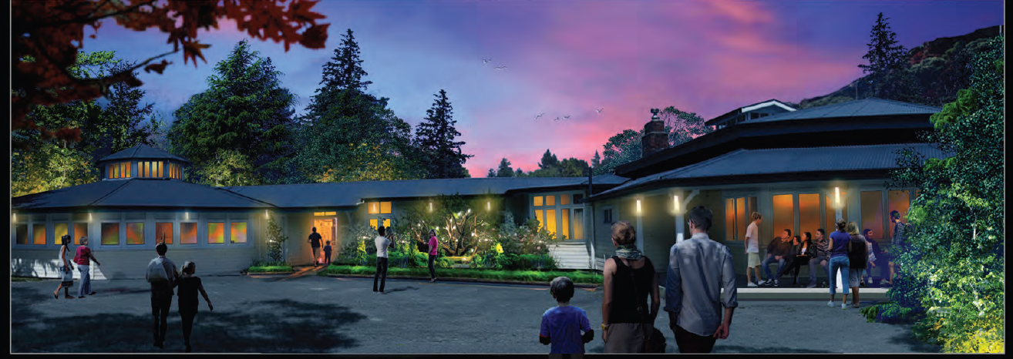
Questions

